Slide 1
VE281 Data Structures and Algorithms
Universal Hashing and Bloom Filter
Learning Objectives:
Know what is Universal Hashing
Know what Bloom filter is and how it works
Know the advantages and disadvantages of Bloom filter

Slide 2

Announcement
Postponing HW1 to 10/12
You can still submit HW today
VM packages will be updated tonight
P1 will be released on Monday

Slide 3


Why VM?
Convenient
Enterprise dev software
Specialized hardware

Slide 4
Universal Hashing
Collision is bad!
For x ≠ y, h(x) = h(y)
Given any fixed hashing scheme, an adversary can create a sequence of inputs that maximizes collisions
Remedy?
The idea of randomization
Similar to quickSort and randomSelect

Slide 5
Universal Hashing
A scheme to produce hashing functions
h = u(p)
We talked about by creating hash function by taking the mod of prime numbers (p)
Foil adversaries by randomly picking p!

Slide 6
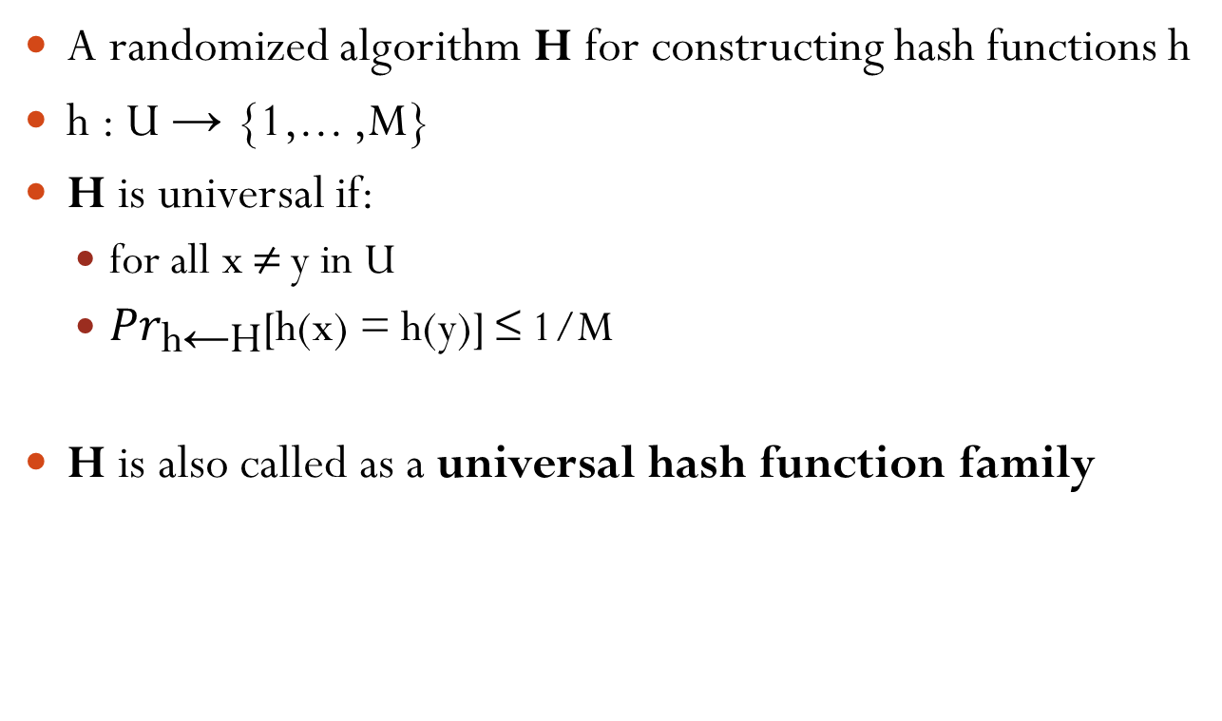
Definition of Universal Hashing
A randomized algorithm H for constructing hash functions h
h : U → {1,... ,M}
H is universal if:
for all x ≠ y in U
${Pr}_{\text{h}\text{←}\text{H}}\text{[}\text{h}\text{(}\text{x}\text{) = }\text{h}\text{(}\text{y}\text{)] ≤ 1/}\text{M}$
H is also called as a universal hash function family

Slide 7
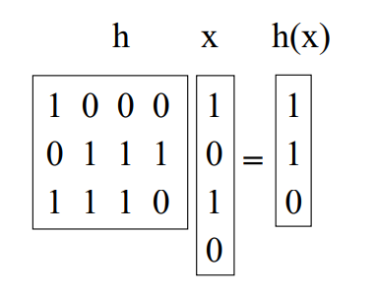
Other Universal Hash Function Families
The Matrix method
Keys: u-bits long
Table size: M=2^{b}
h: b-by-u 0/1 matrix
H: h(x) = h∙x

Slide 8
Proof of Universal

Slide 9
Short break

Slide 10
Bloom Filter
Invented by Burton Bloom in 1970
Supports fast insert and find
Comparison to hash tables:
Pros: more space efficient
Cons:
Can’t store an associated object
No deletion (There are variations support deletion, but this operation is complicated)
Small false positive probability: may say x has been inserted even if it hasn’t been
But no false negative (x is inserted, but says not inserted)

Slide 11
Bloom Filter Applications
When to use bloom filter?
If the false positive is not a concern, no associated objects, no deletion, and you look for space efficiency
Original application: spell checker
40 years ago, space is a big concern, it’s OK to tolerate some error
Canonical application: list of forbidden passwords
Don’t care about the false positive issue
Modern applications: network routers
Limited memory, need to be fast
Applications include keeping track of blocked IP address, keeping track of contents of caches, etc.
Notes:
Spell checker: correct words are in the bloom filter, while incorrect words are not
Forbidden passwords: passwords that are too weak, too easy to guess, or too common. What does it mean by having 0.1% false positive rate? Once out of a thousand, a strong password is thought weak.

Slide 12
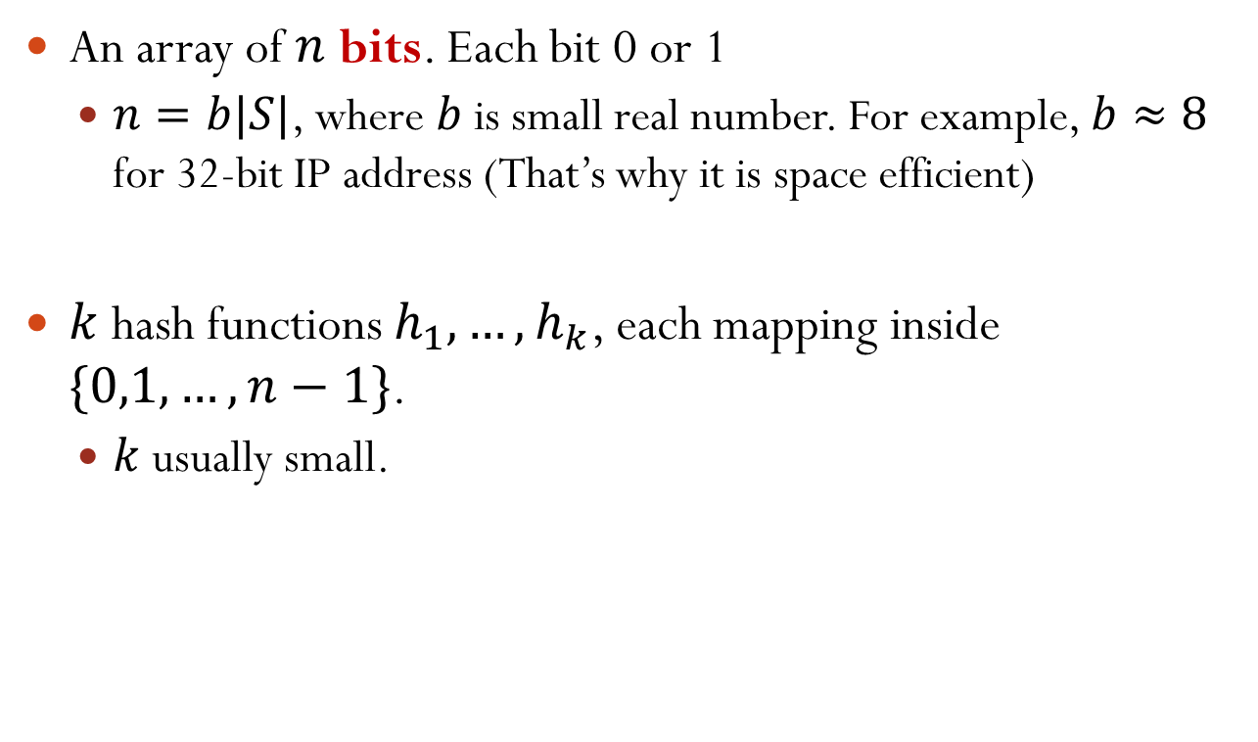
Bloom Filter Implementation: Components
An array of $n$ bits. Each bit 0 or 1
$n=b|S|$, where $b$ is small real number. For example, $b≈8$ for 32-bit IP address (That’s why it is space efficient)
$k$ hash functions $h_{1},…, h_{k}$, each mapping inside $\{0,1,…,n−1\}$.
$k$ usually small.
Notes:
b is a value close to 8. For general hash table, the size in bits is 32 c S.

Slide 13
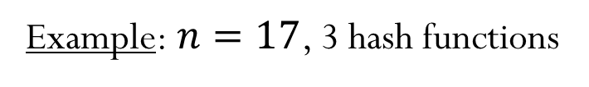





Bloom Filter Insert
Initially, the array is all-zero.
Insert $x$: For $i=1,2,…,k$, set $A\left[h_{i}\left(x\right)\right]=1$
No matter whether the bit is 0 or 1 before
Example: $n=17$, 3 hash functions
$$h_{1}\left(x\right)=7,h_{2}\left(x\right)=3,h_{3}\left(x\right)=12$$
$$h_{1}\left(y\right)=11,h_{2}\left(y\right)=14,h_{3}\left(y\right)=7$$
$$x$$
$$y$$
1
1
1
1
1
0
1
2
3
4
5
6
7
8
9
10
11
12
13
14
15
16

Slide 14



Bloom Filter Find
Find $x$: return true if and only if $A\left[h_{i}\left(x\right)\right]=1,∀i=1,…,k$
No false negative: if $x$ was inserted, find($x$) guaranteed to return true
False positive possible: consider $h_{1}\left(w\right)=11,h_{2}\left(w\right)=12,h_{3}\left(w\right)=7$ in the above example
$$x$$
$$y$$
1
1
1
1
1
0
1
2
3
4
5
6
7
8
9
10
11
12
13
14
15
16
Suppose $h_{1}\left(x\right)=7,h_{2}\left(x\right)=3,h_{3}\left(x\right)=12$. Find $x$?
Yes!
Suppose $h_{1}\left(z\right)=3,h_{2}\left(z\right)=11,h_{3}\left(z\right)=5$. Find $z$?
No!

Slide 15
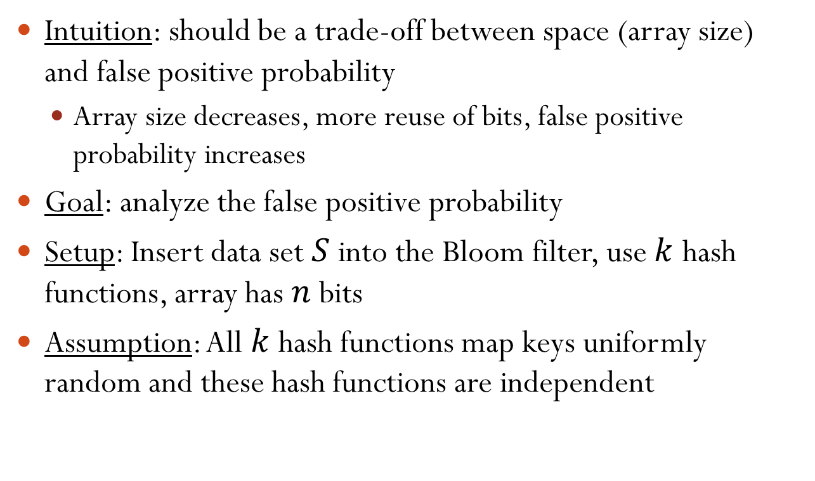
Heuristic Analysis of Error Probability
Intuition: should be a trade-off between space (array size) and false positive probability
Array size decreases, more reuse of bits, false positive probability increases
Goal: analyze the false positive probability
Setup: Insert data set $S$ into the Bloom filter, use $k$ hash functions, array has $n$ bits
Assumption: All $k$ hash functions map keys uniformly random and these hash functions are independent

Slide 16
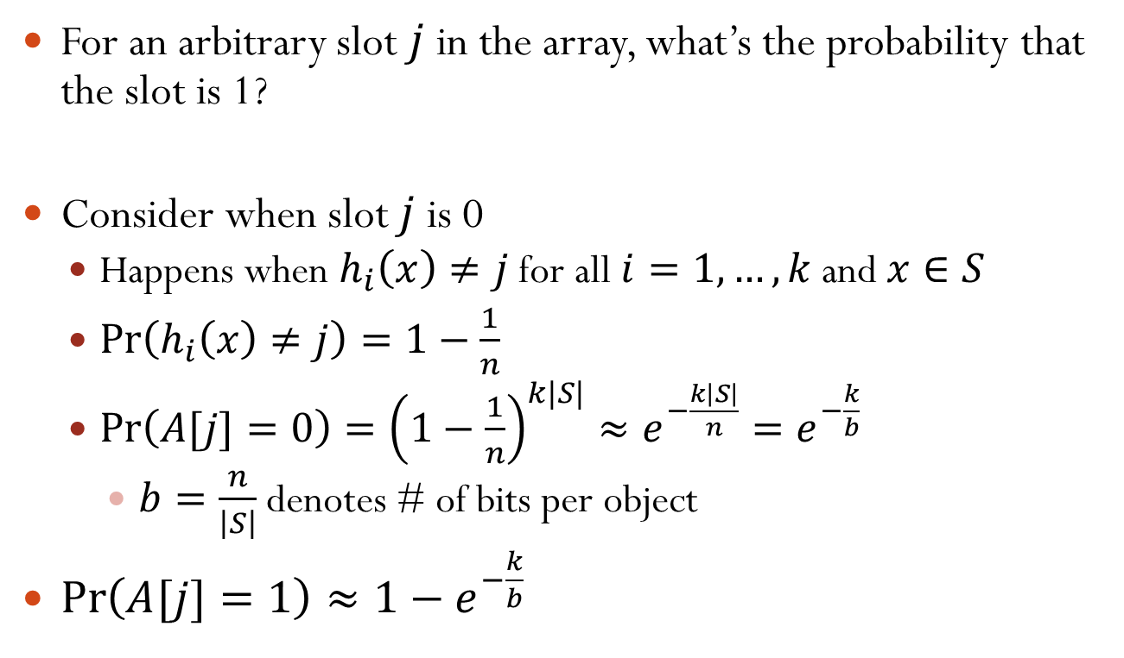
Probability of a Slot Being 1
For an arbitrary slot $j$ in the array, what’s the probability that the slot is 1?
Consider when slot $j$ is 0
Happens when $h_{i}\left(x\right)≠j$ for all $i=1,…,k$ and $x∈S$
$\operatorname{Pr}\left(h_{i}\left(x\right)≠j\right)=1−\frac{1}{n}$
$\operatorname{Pr}\left(A[j]=0\right)={\left(1−\frac{1}{n}\right)}^{k|S|}≈e^{−\frac{k\left|S\right|}{n}}=e^{−\frac{k}{b}}$
$b=\frac{n}{\left|S\right|}$ denotes # of bits per object
$\operatorname{Pr}\left(A[j]=1\right)≈1−e^{−\frac{k}{b}}$
Notes:
lim n->+inf (1-1/n)^{-n} = e

Slide 17
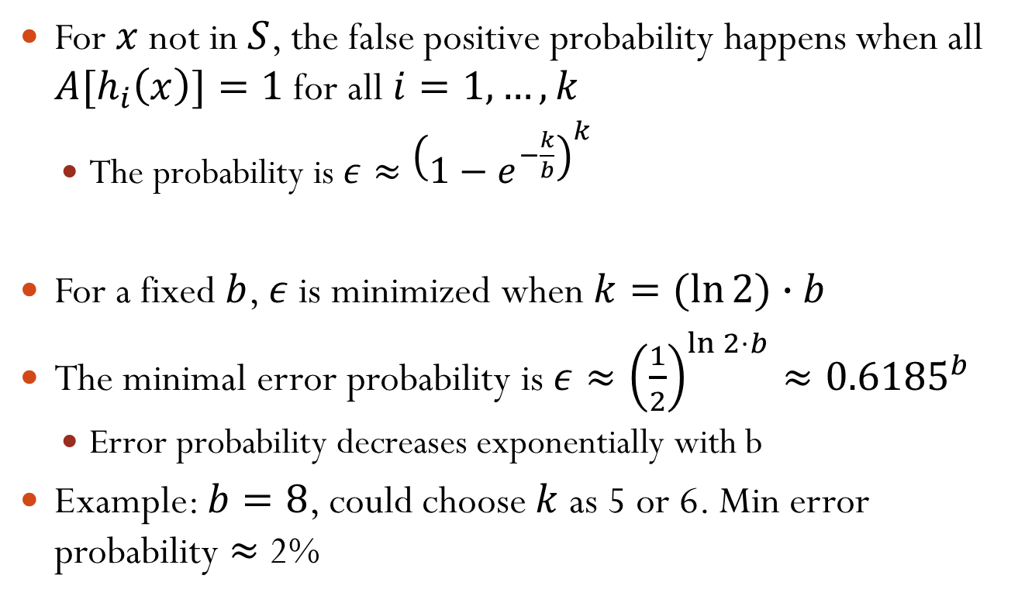
False Positive Probability
For $x$ not in $S$, the false positive probability happens when all ${A[h}_{i}\left(x\right)]=1$ for all $i=1,…,k$
The probability is $ε≈{\left(1−e^{−\frac{k}{b}}\right)}^{k}$
For a fixed $b$, $ε$ is minimized when $k=(ln{2)}∙b$
The minimal error probability is $ε≈{\left(\frac{1}{2}\right)}^{\ln{2}⋅b}≈{0.6185}^{b}$
Error probability decreases exponentially with b
Example: $b=8$, could choose $k$ as 5 or 6. Min error probability $≈$ 2%
Notes:
Error probability decreases exponentially with b: agree with our analysis on the trade-off between error probability and space

